Slide 1
Smart-Home Privacy Dashboard
Project Overwatch
Evan Rodgers, David Lee, Colton Laird, Neal Schobbe

Slide 2
The Problem
Digital ad revenue - $533 billion sector
Amazon+Google 34% share
Need info on consumers to deliver value
Smart home speakers in 31% of US households
Don’t want to HAVE to trust huge corporations

Slide 3
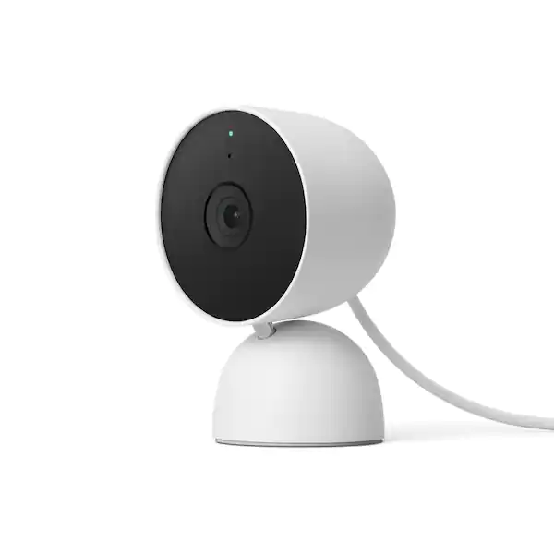
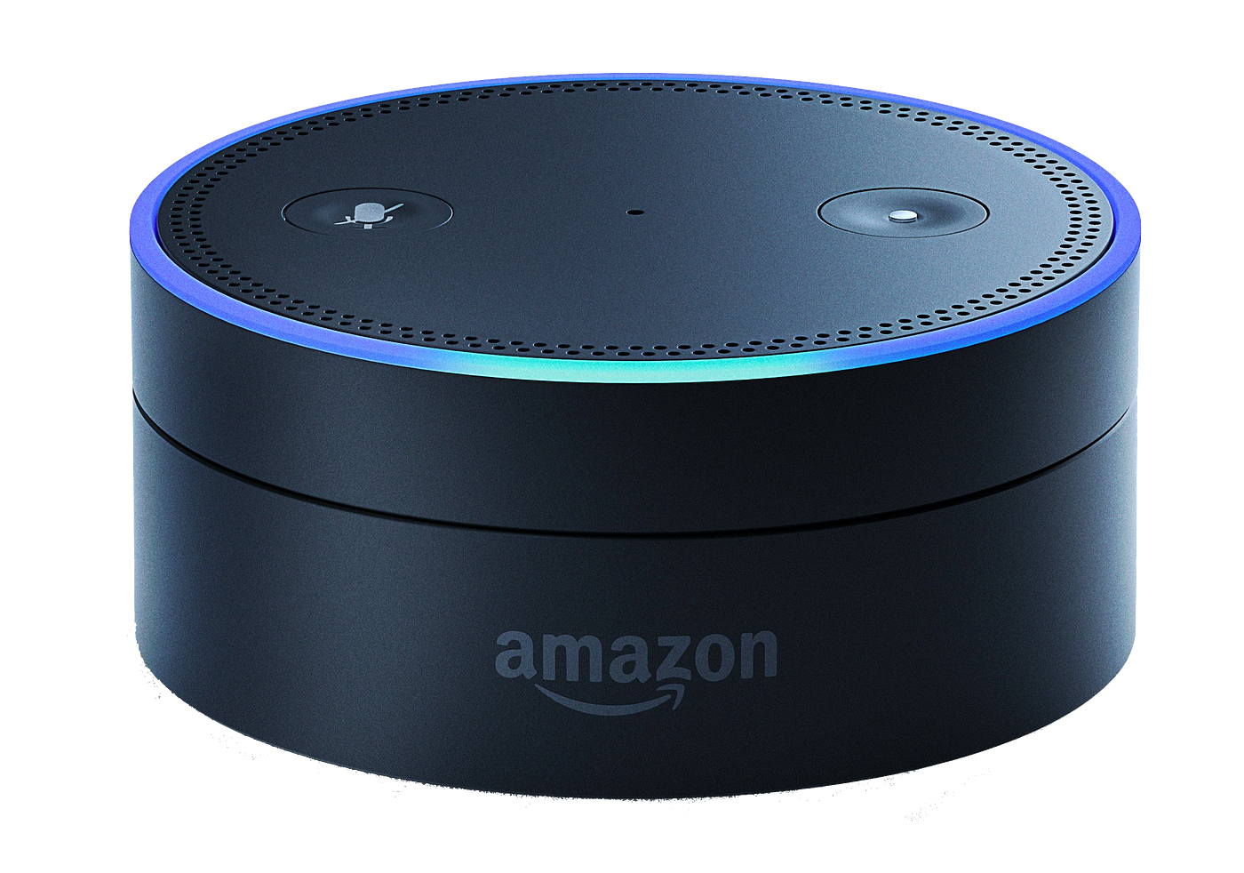
Defining Smart Home Devices
- Gathers info on its surroundings
- Compute on its own
- WAN connected
- Amazon’s Alexa,
- Google’s Nest

Slide 4
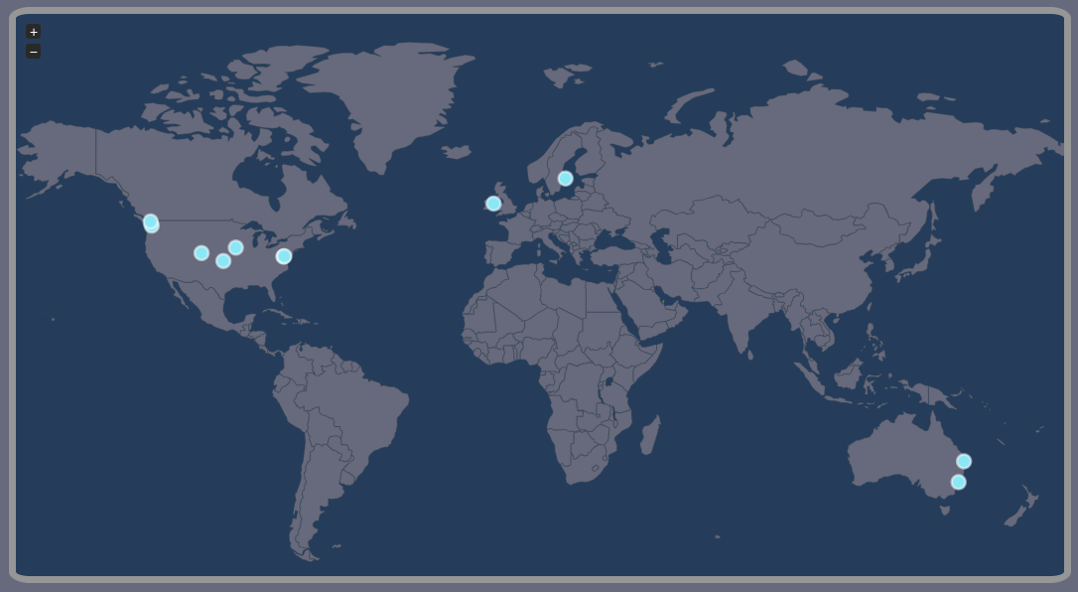
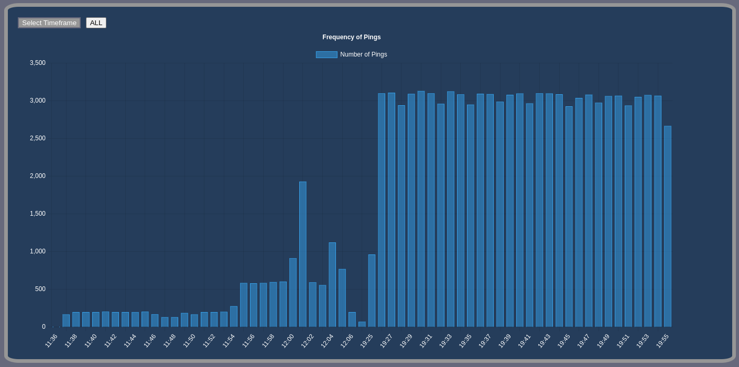
Our Product
-Where and who are these devices communicating with?
-IP of recipient
-Organization name associated with IP
-Geolocation data such as region/city, and
a latitude/longitude.
-Date or Time of when ping occurred
-How often are these devices pinging?
-Frequency
-Repeated IPs
-Traffic size
-Data size

Slide 5



Architecture & Data Flow
- Aretha: open source software under GNU General Public Licence 3
- Does network scraping and packet analysis
- Puts scraped data into PostgreSQL database
- Database is queried by the dashboard
Home Devices
Aretha
Database
Dashboard
Traffic
Organized data
Beautiful data

Slide 6


Slide 7
The Future
-Health of Devices?
-Battery life
-Dead or Alive
-Deviation from routine
- Further extrapolation of received packets.
- Is my data being encrypted?
- Data type?

Slide 8
Questions?
Sources:
https://www.cta.tech/Resources/Newsroom/Media-Releases/2019/May/Americans-Adopt-AI-Smart-Speakers-See-Largest-Gai
https://www.statista.com/statistics/290629/digital-ad-revenue-share-of-major-ad-selling-companies-worldwide/
https://medium.com/@anildash/amazon-echo-and-alexa-really-matter-dcc6d817ad6b
https://www.homedepot.com/p/Google-Nest-Cam-Indoor-Wired-Smart-Home-Security-Camera-Snow-GA01998-US/317816992

